Slide 1
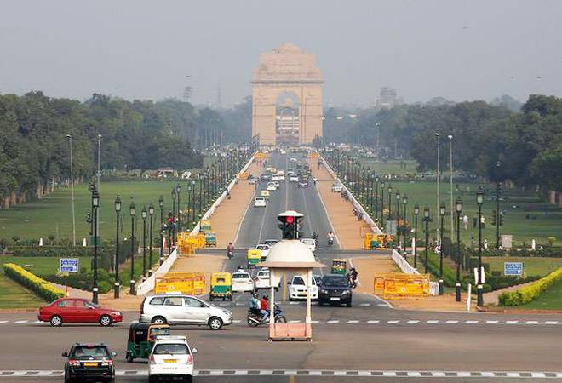
IBM Data Science Professional Certificate
Course 9 – Applied Data Science Capstone
Final Presentation
Analysis on availability of Parks in Delhi (the capital city of India)
By - Gaurav Vajpayee

Slide 2
Business or Environmental Problem-
It is moreover an environmental problem which has link to business as well. Real Estate projects with parks in the areas which have less parks can be an attractive deal for customer.
It is important to handle this problem in a more analytical way and the problem statement for this problem would be how we can decide which part of the Delhi has got good number of parks and which are facing the scarcity of them?

Slide 3
Data Required-
List of all the neighborhoods of Delhi city .
Latitudinal and Longitudinal data of these neighborhoods .
Venue data of these neighborhood particularly availability of parks in these neighborhood.
Data Sources –
(https://en.wikipedia.org/wiki/Category:Neighbourhoods_in_Delhi) From this Wikipedia page we are taking out list of neighborhood of Delhi.
To get the geographical coordinates of these neighborhood we will be using Python package called Geocoder .
To get the venues data related to the neighborhood we will be using Foursquare API . Foursquare is widely used among developers for geospatial data. In venues we will particularly focus on parks present in the neighborhood.

Slide 4
Methodology-
Firstly we will be taking out the list of all neighborhoods present in Delhi city from a Wikipedia page (https://en.wikipedia.org/wiki/Category:Neighbourhoods_in_Delhi ) by using the technique called web scraping with the help of a Python package called Beautifulsoup. This package helps to extract html data and store it in our program for further usage. This extracted list of neighborhoods is stored in a python datatype of “list”.
Then with the help of Python package of Geocoder we get geographical coordinates of these neighborhoods stored in a list.
Now we merge the coordinates list with our neighborhood list and plot these neighborhood on map with the help of Python library called Folium
Now we call Foursquare API using our credentials to get top 100 venues data about these neighborhood within 2000m radius of distances. Foursquare is widely used among developers to get geospatial data which is authenticate and updated on the regular basis.

Slide 5
Methodology-
With the help of one hot encoding we will convert our venue data into 0 and 1 for easy application of machine learning techniques on this data.
Now we take mean of the frequency of occurrence of different venue category. By this we are preparing our data for K-means clustering .
Lastly , we will perform clustering on the data by using K-means clustering. This algorithm identifies k number of centroids and then allocates every data point to the nearest cluster whole keeping the centroid as small as possible .It is one of the simplest and popular unsupervised machine learning algorithm and is particularly suited to solve the problem for this project. Here we will be clustering our neighborhoods into three clusters based on their frequency of occurrence of Parks .
By this we will be able to identify the areas having higher number of parks, the areas having low parks and areas have moderate number of parks

Slide 6
Results –
By clustering the neighborhoods into 3 categories based on the frequency of occurrence of “ Parks” we got following resulting clusters.
Cluster 0 - neighborhoods falling in this category are have very less frequency of occurrence of Parks.
Clusters 1 - neighborhood falling in this category have high frequency of occurrence of Parks.
Clusters2-neighborhood falling in this category have moderate(between high and low) frequency of occurrence of Parks.
The map plotting shows results in more visualized representation of different clusters in which purple dots showing cluster category 1 , green dots showing cluster category 2 and red dots showing cluster category 0.

Slide 7
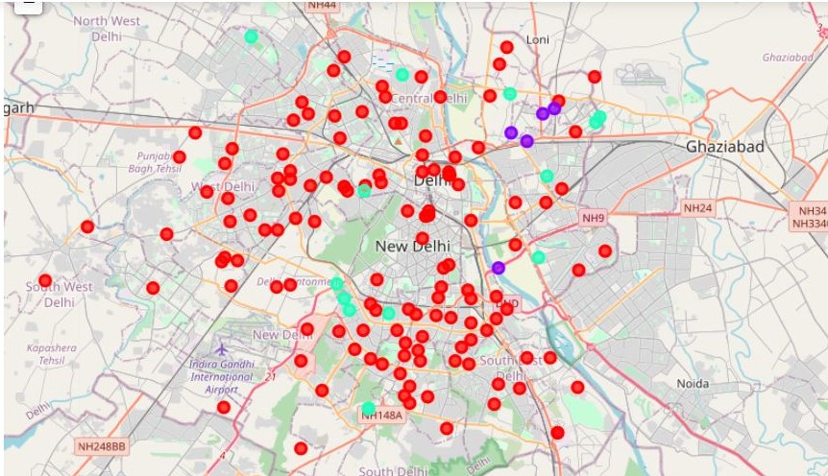
Plot of neighborhood clusters

Slide 8
Conclusions-
By doing this project we came to a conclusion that most of the neighborhoods which have high or good number of parks are located in eastern part of Delhi whereas some neighborhoods of south and east Delhi have moderate number of parks.
Whereas neighborhoods with low number of Parks are maximum in number and are located in almost entire area of Delhi but mostly the neighborhoods of western Delhi are facing this problem.
This data analysis can be important to locate the places with less number of parks and can be beneficial for future development purposes of Delhi.

Slide 9
Thank You

